Slide 1
Economics 12
Unit 1 – INTRODUCTION TO ECONOMICS

Slide 2
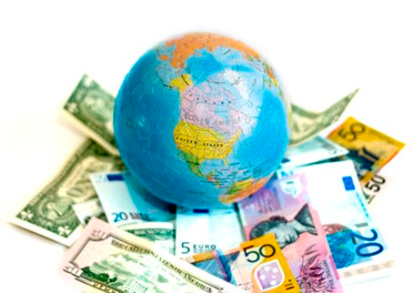
What is Economics?
Oxford Dictionary Definition:
The branch of knowledge (now regarded as one of the social sciences) that deals with the production, distribution, consumption, and transfer of wealth; the application of this discipline to a particular sphere; (also) the condition of a state, etc., as regards material prosperity; the financial considerations attaching to a particular activity, commodity etc.

Slide 3
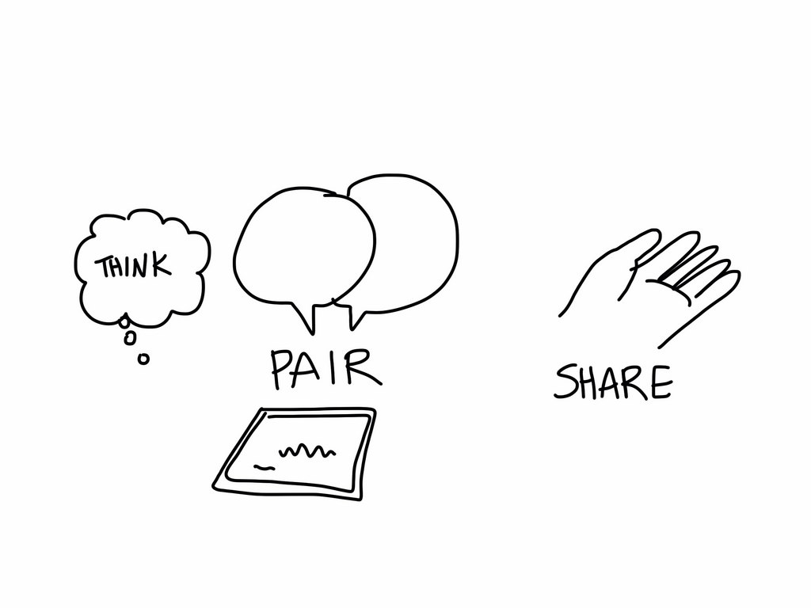
Think Pair Share- What is Economics?
With a partner, come up with 5 different words that you think are associated with Economics
Be prepared to share with the rest of the class!

Slide 4
What is Economics?
Saint Michael's College
answers "Most simply put,
economics is the study
of making choices.“
Mike Moffat (Canadian Economist) answers
"Economics is the study of how individuals and groups make decisions with limited resources as to best satisfy their wants, needs, and desires".
?

Slide 5
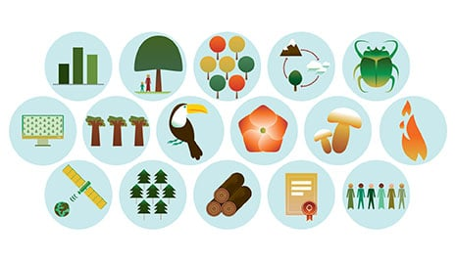
What is Economics?
Wait a tick… What’s an Economy?
“The wealth and resources of a country or region, especially in terms of the production and consumption of goods and services”
“The total value of everything produced within a particular geographic area”

Slide 6
What is Economics?
Common words and ideas used to describe economics:
Daily movements in the stock market
Interest rate
Unemployment rate
Inflation
Supply and Demand
GDP (Gross Domestic Product is the total value of all goods and services produced in an economy)
That’s a lot! So maybe we should pick it apart…

Slide 7
ADD NEW CONTENT 2018
**** INSERT HISTORY OF ECONOMICS HERE!!
https://www.investopedia.com/articles/economics/08/economic-thought.asp

Slide 8
What is Economics?
Broadly speaking, there are two kinds of economics….
Can anyone guess what those two are??

Slide 9
Microeconomics vs Macroeconomics

Slide 10
MICRO
small
Deals with economic decisions made at a low, or micro level
Examples: Consumers, households, companies and industries
Analysis of the decisions made by individuals and groups, the factors that affect those decisions, and how those decisions effect others
The price of gasoline has increased, how will I afford the change?
If my husband’s wage rises, will I be able to work from home?
If we lower the price of our cars, how will consumers respond?
What changes can our company make to compete with McDonald’s low prices?

Slide 11
MACRO
BIG
Concerned with the performance of whole economies
Economy of a region: BC
Economy of an entire country: Canada
Economy of supra-national bloc of countries: North America
Common Questions:
What is the level of GDP in a country?
What’s going on with the unemployment rate across Canada?
What is causing inflation?
Should interests rates rise or stay the same?

Slide 12
Think Pair Share- Micro & Macro
With a partner, come up with a micro level scenario/question and a macro level scenario/question.
Be prepared to share with the rest of the class!

Slide 13
Micro Vs Macro
Microeconomics and Macroeconomics are NOT independent of each other
You have to understand one to better understand the other
Example: Q. If the Bank of Canada increases interest rates, how will that effect the economy? (Macro)
A. Will consumers borrow less money to buy Canadian products because of increased inflation rates? (Micro)
B. With less consumption, will profits from taxes suffer and cut government programs?

Slide 14
Quick Review
What is…
Economics?
An Economy?
What is Microeconomics?
What is Macroeconomics?
Unemployment in Canada- Micro or Macro?
Mom just got a raise – Micro or Macro?

Slide 15
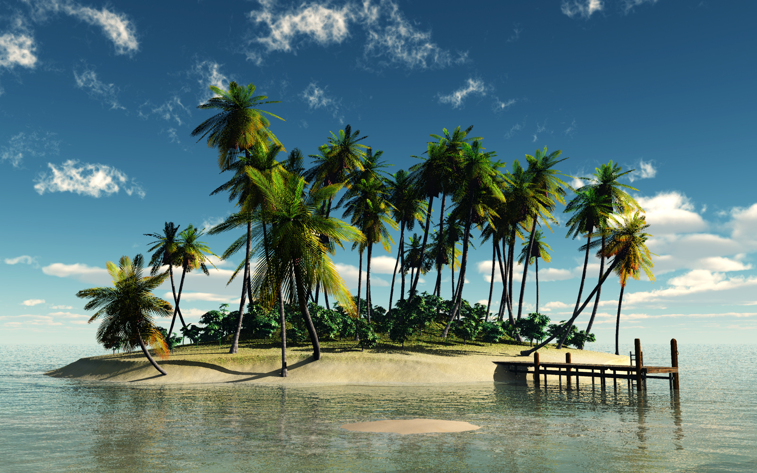
Stranded on Gilligan's island

Slide 16
Island Simulation
You are all on an island that is three miles long and one mile wide. The island is located in a large ocean. This island is not on any map. No plane or ship passes it. A warm water current flows past the island. The highest elevation is a three hundred foot hill at the north end of the island. A cave is in the hill. In the cave is a box. The box is in a puddle of water. Inside the box is 500 pounds of what. The what is not wet. The box is waterproof. There is a fresh water spring on the island. One-third of the island is covered with plants. The rest of the island supports no vegetation.
The transportation which brought you to the island is wrecked and sunk in deep water. If you were on a ship, the ship is sunk three miles away. Nobody knows where you are. The last time you touched land was 1,000 miles away. Nobody there knew where you were going. If you traveled by air, all contact with others was lost. Your radio went out when you were 1,000 miles away from your departure point. You have not been on anyone's radar for 800 miles. In either case, no message for help was sent. Through a miracle, no one was hurt. You are as well as you are right now.
What is the plan? How will your survive?

Slide 17
To summarize:
You are stuck on the island! No one can rescue you and there’s no escaping
You can grow food on a third of the land
You have access to clean water
You have 500lbs of a resource(s) of your choice in a waterproof box (no escape ploys)
It’s you and your group only as you are now.
WHAT IS YOUR PLAN FOR SURVIVAL?

Slide 18
Things to Consider
Do we know that there is no one else there?
Do we know if we need protection here?
What do we have?
What do we need?
Who will be our leaders?
How will we divide tasks?
How will we divide resources?
What should we do to get started?
What should we do in the first 24 hours?

Slide 19
Group Dynamics
Who began to assume dominance over the group in terms of leading the discussion or making the most suggestions.
Who made the most reasonable suggestions? What was the group reaction to these?
What was the first decision made by the entire group? How was it made (domination by one or a few; apathy by the majority; vote by the group; etc.)?
Who became the group recorder? How did the person get the responsibility?
What was the first rule the group established?
How did the group deal with the concept of Scarcity?
(Put on other side of the paper)

Slide 20
Why did we do this??
This activity brings up a number of Economic topics:
Who’s in charge? Politics
What do we need to survive? Materials, Money/Exchange, Food
How do you determine who gets what? Distribution of Wealth
How much food is on the island? Supply
Do different people have different needs? Demand
What are you willing to give up for something else? Scarcity

Slide 21
The Economic PRoblem

Slide 22
What is Economics?
Economics is the study of the use of scarce resources to satisfy unlimited human wants.
What are Resources?
Another term for resources: factors of production (specifically for labor, land and capital)
Goods (tangible) versus Services (intangible)
Production – act of making resources
Consumption – act of using resources to satisfy wants

Slide 23
The Economic Problem
http://www.investopedia.com/terms/s/scarcity.asp
Scarcity is inevitable and is central to economic problems.
Def: The basic economic problem that arises because people have unlimited wants but resources are limited. Because of scarcity, various economic decisions must be made to allocate resources efficiently.
What are society’s resources?
What are some of Canada’s resources?
Why is scarcity inevitable?
Greeeeeed (unlimited wants)
What are the consequences of scarcity?
You need to make a choice! (Opportunity Cost)

Slide 24
The Economic Problem
Discussion: What are some wants you have? Needs? What is the difference between the two?
Think of a time when you were faced with Scarcity. What did you have to do?

Slide 25
The Economic Problem
Choice
Scarcity implies the need for choice
Problem of deciding what to produce and how much each person will consume.
Who makes the choices?
How are those choices made?
Making choices implies the existence of costs

Slide 26
OPPORTUNITY COST
Missing out on the benefits of an alternative option

Slide 27
What is Economics?
Opportunity Cost
The opportunity cost of using resources for a certain purpose is the benefit given up by not using them in the best alternative way.
The cost is the benefits you could have had with the other alternative
INVESTOPEDIA EXPLAINS 'Opportunity Cost'
1. The opportunity cost of going to college is the money you would have earned if you worked instead. On the one hand, you lose four years of salary while getting your degree; on the other hand, you hope to earn more during your career, thanks to your education, to offset the lost wages.
Here's another example: if a gardener decides to grow carrots, his or her opportunity cost is the alternative crop that might have been grown instead (potatoes, tomatoes, pumpkins, etc.).

Slide 28
Opportunity Cost Assignment Time

Slide 29
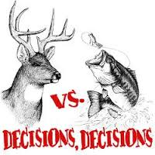
Review from the last few days…
Go back to the island, can you think of a situation where you would have had 2 opportunities but not enough resources to complete them both? This puts you in a position where you have scarce resources and you have to make a choice. This leads to opportunity cost.
There are situations however, where you don’t have to choose between one or the other. The catch? You’ll have to figure out the best way to divide your time and resources for maximum potential. → Production Possibility Frontier

Slide 30
http://www.investopedia.com/terms/p/productionpossibilityfrontier.asp

Slide 31
Production Possibility frontier
How many refrigerators can you produce while also making cars?

Slide 32
Four Key Economic Problems- Reading
What is produced and how?
What is consumed and by whom?
Why are resources sometimes idle?
Is productive capacity growing?
Read pages 8(star) to 10 (star)

Slide 34
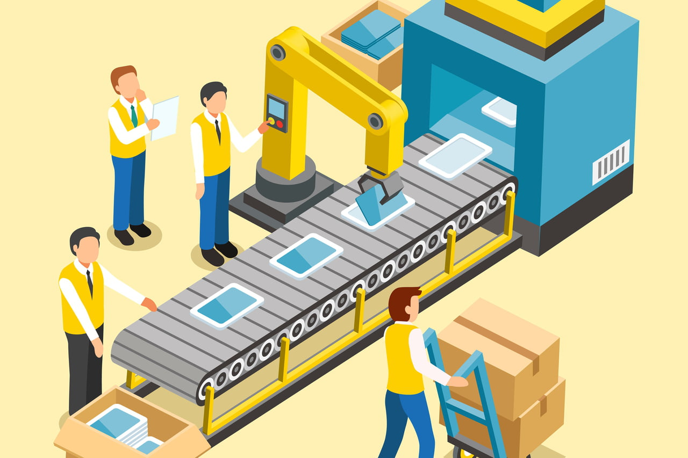
What is produced and why?
What is resource allocation?
Where does this fall on the production possibility curve?
Why should resources be used most efficiently?

Slide 35
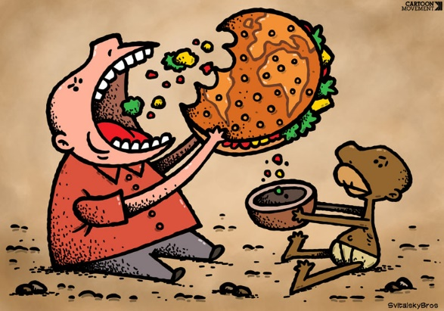
What is consumed and by whom?
Is distribution of goods equal?
What would allow an economy to consume more or a different combination of goods in a country?
Does this question fall under micro economics or macro economics?

Slide 36
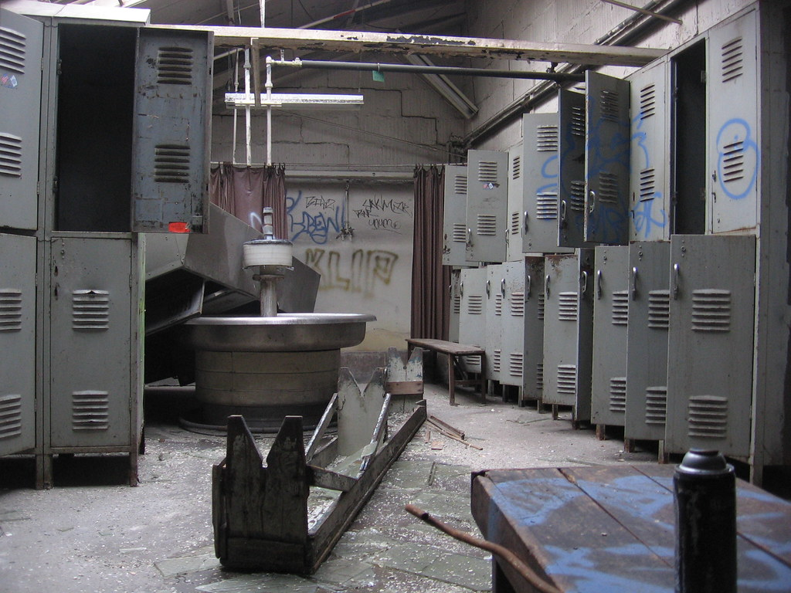
Why are resources sometimes idle?
What does it mean when resources are idle?
Where would a company’s production of resources fall on the production possibility curve if resources are idle?
When would you see idle resources?

Slide 37
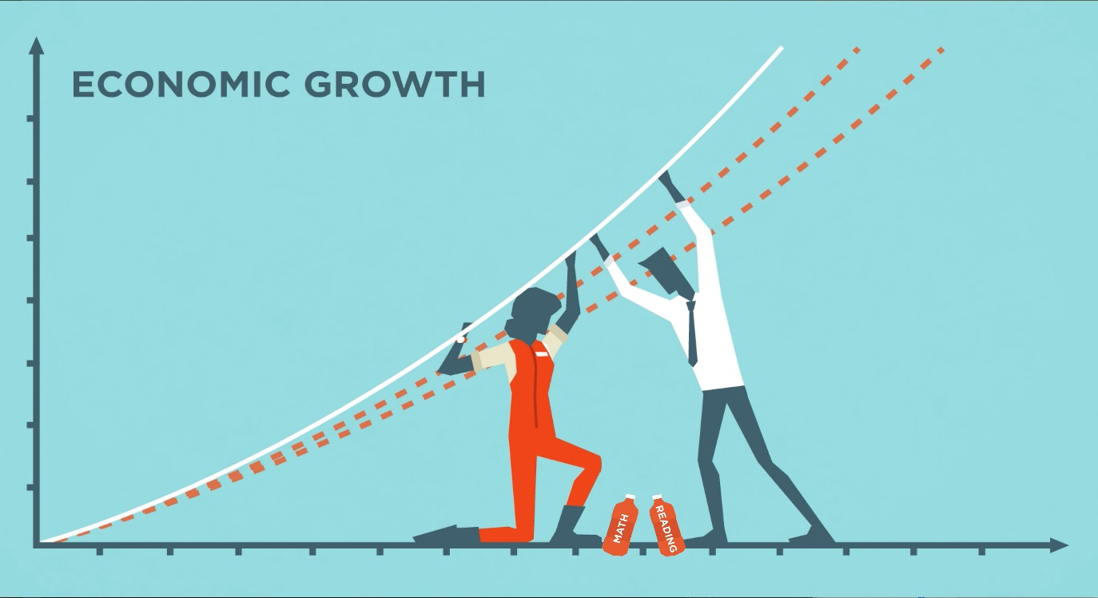
Is production capacity growing?
Where does productive growth fall on the productive possibility curve?
Is it possible to have growth?
Does this questions fall under micro or macroeconomics? Why?

Slide 38
Assignment 2
From the reading today and discussions thus far in class, complete questions 1-10. You are permitted to work in partners

Slide 39
Economic Systems
An economic system is a distinctive method of providing answers to the basic economic questions.

Slide 40
Alternative economic systems
3 pure types of systems + 1 mixed:
Traditional Systems
Command Systems – synonymous with centrally planned economy
Market Systems – often called free-market economy
Mixed systems
Differ in the way in which economic decisions are coordinated
Read page 10 (star) to 11 (star)
Discuss systems then complete assignment

Slide 41
Group Reading
Get into groups of 4
You will be assigned an Economic System
Discuss how the following for economic problems would be answered in your economic system
What is produced and how?
What is consumed and by whom?
Why are resources sometimes idle?
Is productive capacity growing?

Slide 42
Alternative Economic Systems
Ownership of Resources
Economies differ as to who owns their productive resources
Private-ownership economy
Public-ownership economy
Coordination-Ownership Mix
4 possible combinations – two most common
Private-ownership market economy
Public-ownership planned economy

Slide 43
Unit 1 – Assignment #2
Complete the last page of assignment 2

Slide 44
Quiz Next Class!
What is Economics?
Micro vs Macro (individuals/firms/industries/gov.)
Resources/Factors of Production/Scarcity/Opportunity Cost/Productions Possibility Frontier
4 Economic Problems
4 Economic Systems (continued today!)
Traditional First Nations Economic systems

Slide 45
The Evolutions of Economic Systems

Slide 46
Aspects of a Modern Economy
Modern market economies first arose in Europe - grew up from the (traditional) feudal system
Changes in population, war, modern advancements etc., directed a change in systems
Now: Involvement in the market is voluntary
Private property
Freedom of contracts (Free Market)
Both maintained by active government policies

Slide 47
Rise of the Working Class
Read (independently) “The Failure of Central Planning” on page 12-13
Discuss with your partner the following questions:
What caused overages and shortages of goods?
Why was quality so poor?
Why was there a lack of incentives for workers?
How was the environment affected?
Report out to the class

Slide 48
Review of the Systems
https://www.youtube.com/watch?v=B43YEW2FvDs
“Economic Systems and Macroeconomics: Crash Course Economics # 3”
10 mins

Slide 49
Economic Systems are Changing
FREE MARKET
PLANNED ECONOMY
CAPITALISM
SOCIALISM

Slide 50
Causes of Change
Living Standards
Depend on how much society can consume of various goods and services
Small productive capacity = low living standards
Key components
Employment
Labour Productivity
Distribution of Income

Slide 51
Ongoing Change
Continual technological change
Job structure
Decline in agriculture, rise in service sector
New products
Continual introduction of new products
Globalization
Know where a product is assembled but not necessarily where it is made
Rapid reduction in transportation costs/revolution in communication
Large firms seek physical presence in major countries

Slide 52
Today: Economic Analysis & Policy
The pervasiveness of policy decisions
From laissez-faire policy to strict control over every facet
Debates over means and ends
Goals, the things we strive for, are called ends
Means are the methods of achieving our goals (or ends)
Debate about the right degree of government involvement = alternative means to achieve agreed ends
Different groups put different values on alternative ends

Slide 53
Economic Analysis & Policy
Four questions can be asked about every proposed economic policy
What are the policy goals?
Does the proposed policy achieve those goals?
Does the proposed policy has adverse side effects?
Are there alternative means of achieving the goals?

Slide 54
Make up quiz and Project next class!

Slide 55
Unit 1 – Assignment #2
Read pages 14-23 (1. The Economic Problem)
Answer the questions #1-10 in Unit 1 – Assign #2 (hand out)

Slide 56
The History of Economics
…in a nutshell

Slide 57
Economic Schools of Thought: Crash Course Economics
https://www.youtube.com/watch?v=tZvjh1dxz08

