Slide 1
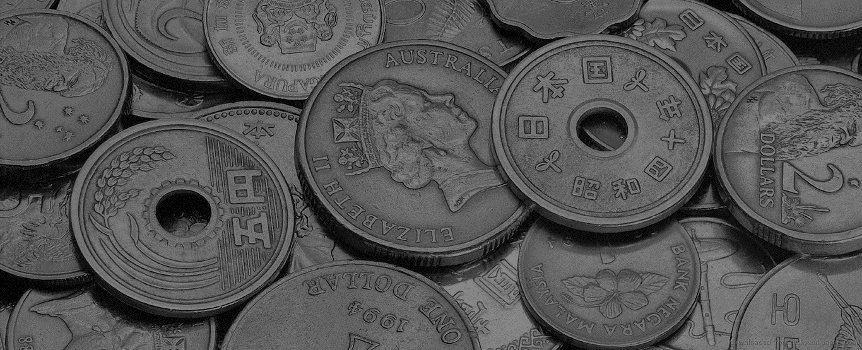
UNIT 2
History of Economic Theories and the Canadian Economic System

Slide 2
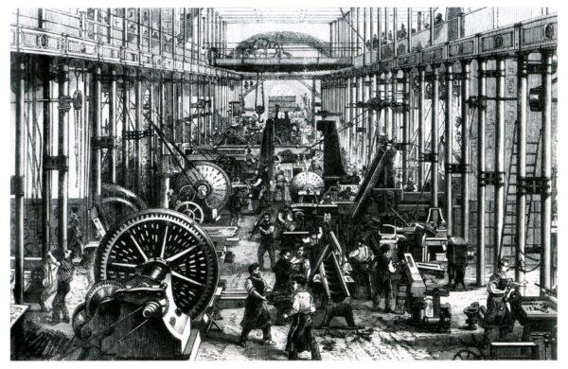
Evolution of Economics
Modern economic thought emerged in the 17th and 18th centuries as the western world began its transformation from an agrarian to an industrial society (a time when philosophy, science and technological advancements were booming)

Slide 3
Evolution of Economics
As society modernizes, Economic theories continue to develop and change to best suit the current economic environment.

Slide 4
Activity- Positive Polly/Paul vs. Negative Nancy/Ned
Get into partners
Assign the Pro partner and Con partner
Take 2 minutes to write down arguments for each of the questions below
Have a mini debate on each question with your partner
Report out
What are the pros and cons of Free Trade? What are the pros and cons of Tariffs?
What are the pros and cons of government involvement in a country’s economy?
What are the pros and cons of taxes and government spending?

Slide 5
16th -18th Century Theories
Economic Theory | Wealth defined as: | Originated in: | Theory:
Mercantilism 16th-18th Century | Accumulation of Gold and Coins | Across Europe | Promote Exports and Tarriffs
Physiocrats 1694–1774 | Productive work, Agriculture, and Land Development | France | Laissez Faire, minimize trade
Classical School of Thought 18th-19th Century | National income based on labor, land and capital | Britain | Free Trade

Slide 6
Crash Course!
https://www.youtube.com/watch?v=tZvjh1dxz08
This is super fast…but we will summarize after!

Slide 7
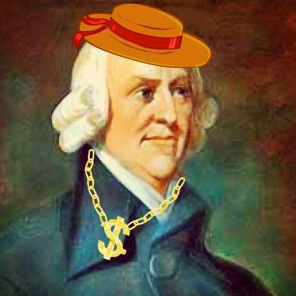
Adam Smith – “Father of Economics”
Classical School of Thought
Began with The Wealth of Nations- a 1776 publication of Adam Smith’s work
3 factors of production and major contributors to a nation’s wealth
Land
Labor
Capital
Ideal Economy: a self regulated market system that automatically satisfies the economic needs of the populace
The invisible hand- leads all individuals in the pursuit of their own interest, to produce the greatest benefit to society as a whole
Includes Physiocrats’ ideas like laissey faire, but agriculture is not the only form of production
1723 - 1790

Slide 8
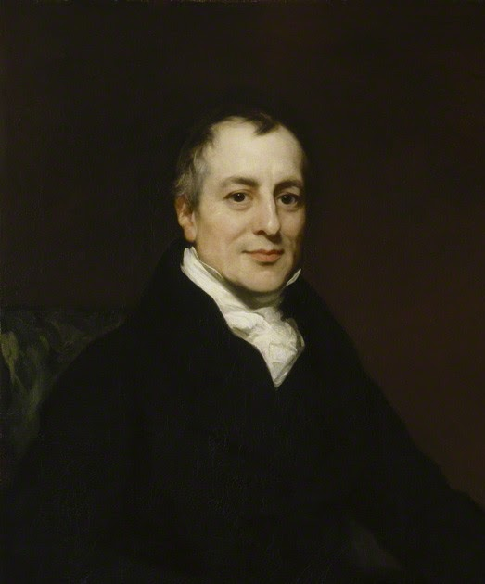
David Ricardo 1772 - 1823
Classical School of Thought
While Adam Smith focused on production of income, David Ricardo emphasized the distribution of income – landowners, workers and capitalists
Conflict between landowners vs laborers and capitalists
Growth of population (laborers and capitalists, against a limited supply of land means and increase in rent and holds down wages and profits)
His theory of Comparative Advantage proves that trade (especially free trade) benefits all parties

Slide 9
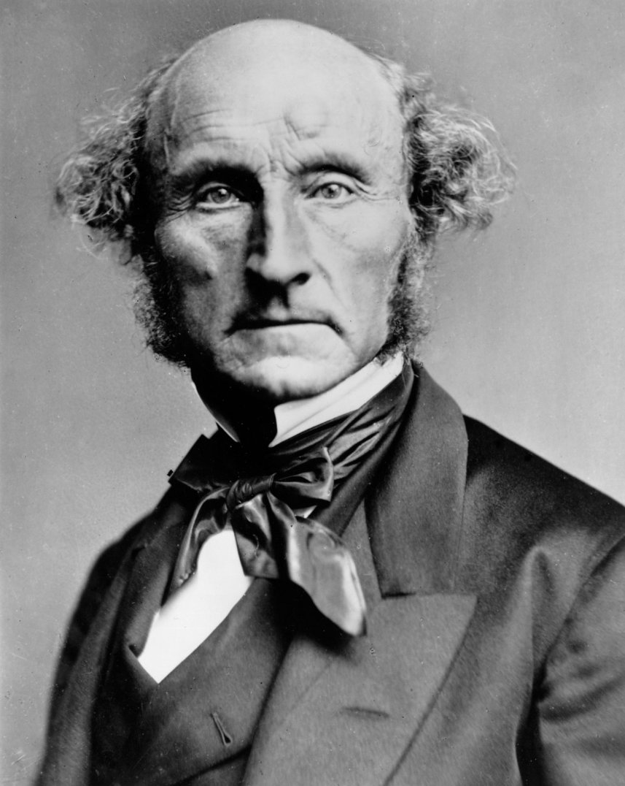
John Stuart Mill 1806 – 1873),
Classical School of Thought with a touch of Socialism
Agreed with most classical theories concerning a free market, BUT, he began to promote a more socialist view that required some government interventions to provide a better society
Promotes a more even distribution of income
Can’t truly trust the invisible hand!

Slide 10
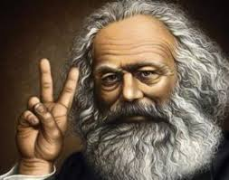
Karl Marx 1818 - 1883
Marxist School of Thought
Inspired by struggles between social classes (ruling class vs working class)
Believed capitalism would implode and be succeeded by a world with out private property
The Labor Theory of Value: The value of a product is determined by how many hours it takes to produce it.
Here therefore felt owners (capitalists) exploited by workers by not paying them enough for their labor
Socialism, Marxism, Communism
The struggle is real

Slide 11
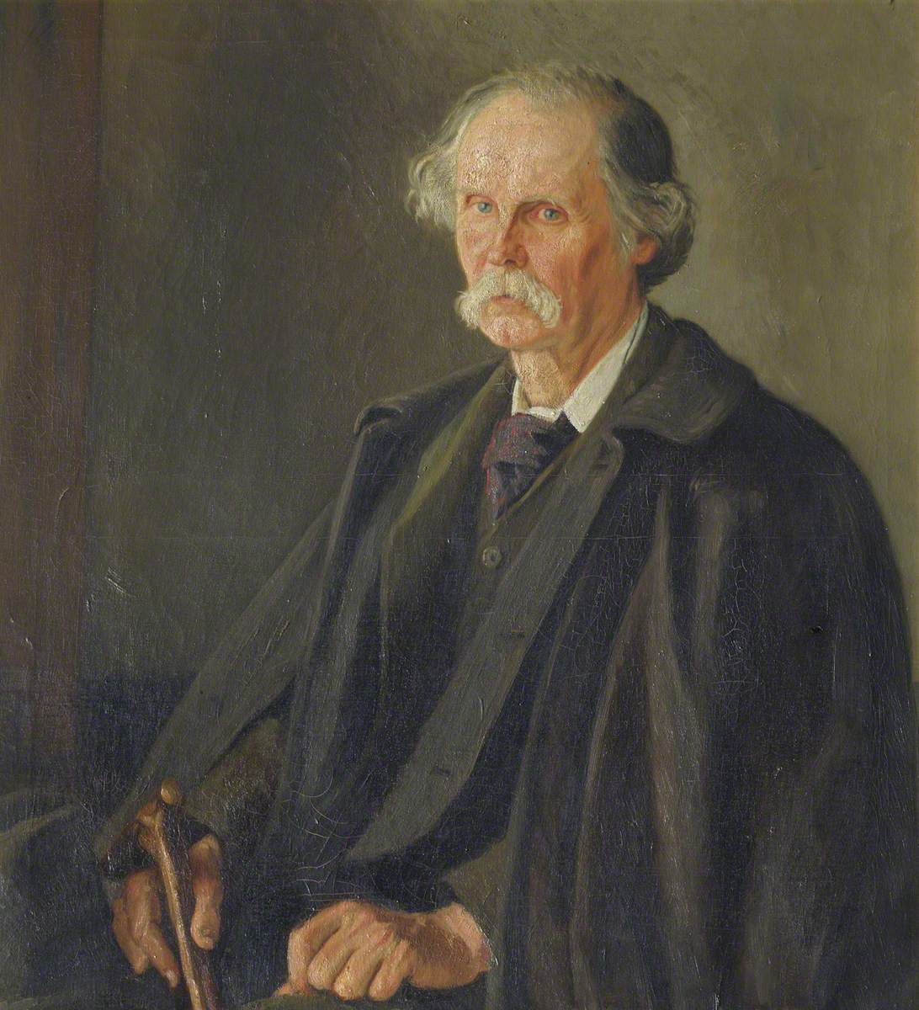
Alfred Marshall 1842 - 1924
Neoclassical Economics (the new Classical Economics)
Laissez Faire
Supply and Demand, Marginal Utility and Costs of Production
We’ll talk more about this later!

Slide 12
Fiscal Policy
“Fiscal policy refers to the use of government spending and tax policies to influence macroeconomic conditions, including aggregate demand, employment, inflation and economic growth.”
Investopedia.com

Slide 13
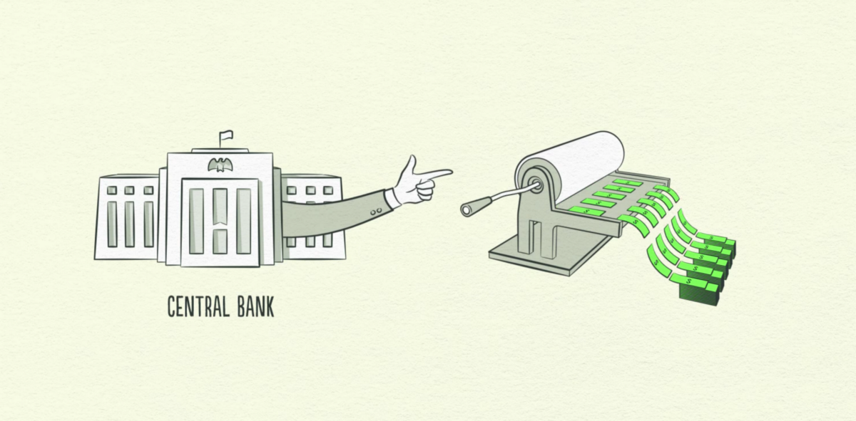
Monetary Policy
“Monetary policy consists of the actions of a central bank, currency board or other regulatory committee that determine the size and rate of growth of the money supply, which in turn affects interest rates. Monetary policy is maintained through actions such as modifying the interest rate, buying or selling government bonds, and changing the amount of money banks are required to keep in the vault (bank reserves).”
Investopedia.com
The Bank of Canada is in charge of Monetary Policy in Canada
Federal Reserve in USA

Slide 14
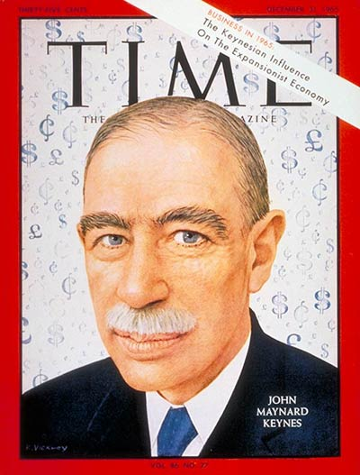
John Maynard Keynes 1883 - 1946
“His major policy view was that the way to stabilize the economy is to stabilize the price level, and that to do that the government’s central bank must lower interest rates when prices tend to rise and raise them when prices tend to fall.”
Keynes believed that direct government intervention was necessary to increase total spending in a time of recession (fiscal policy)

Slide 15
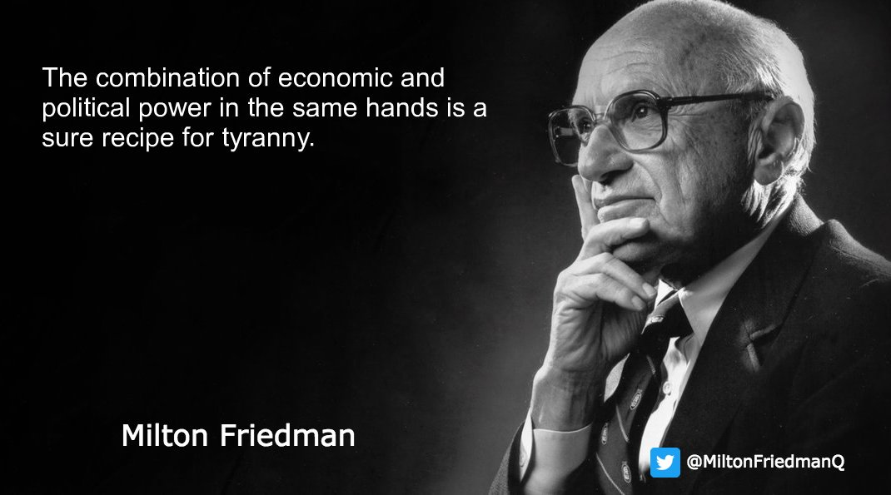
Milton Friedman 1912-2006
Advocate for free market capitalism which opposed John Maynard Keynes ideas of fiscal policy
“Free Market Monetarism”
“Friedman argued for free trade, smaller government and a slow, steady increase of the money supply in a growing economy”
Investopedia.com

Slide 16
Monetarism
The total amount of money in an economy is what determines the wealth and economic success of a country (like gold and silver in Mercantilism and Productive work in Physiocrat theories)
With this theory, the government should keep the supply of money at bay and only increase it slightly to promote growth in the economy
**Not Monetary Policy

Slide 17
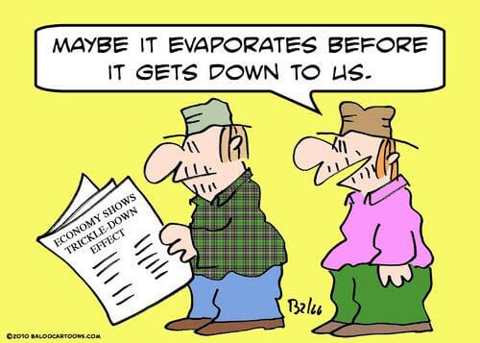
Trickle Down Economics
The idea that the benefits from tax breaks for the wealthy would ‘trickle down’ and provide economic benefits for lower income brackets as well.
Tax breaks for the wealthy and large businesses would help stimulate the economy
*HOWEVER, this assumes that all people work for the great good…

Slide 18
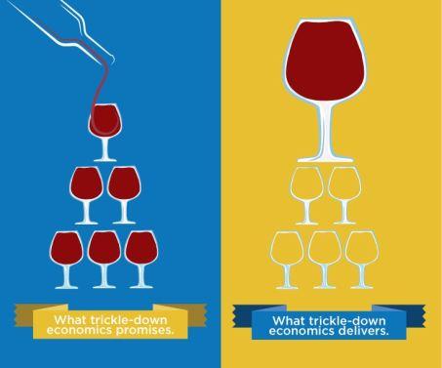

Slide 19
New Neo Classical Synthesis
Neoclassical Economics (market determined by supply and demand)
+
Keynesian Macroeconomics (economic policy responses)

Slide 20
Which Economic influences do you think you see in Canada’s Economy?

Slide 21
The Economy of Canada

Slide 22
Reading – “The Economy of Canada”
http://www.thecanadaguide.com/basics/the-economy/
Economic History of Canada
Canada’s Modern Economy and Industries
Trade and the United States
Taxes in Canada

Slide 23
Canadian Fiscal Policy

Slide 24
Aggregate Demand
Aggregate Demand is the total level of spending in the economy, including consumption, investment, government spending and the difference between exports and imports. (H. Richard Hill)
The Economy’s total output, income and employment levels are directly related to aggregate demand
https://www.investopedia.com/terms/a/aggregatedemand.asp

Slide 25
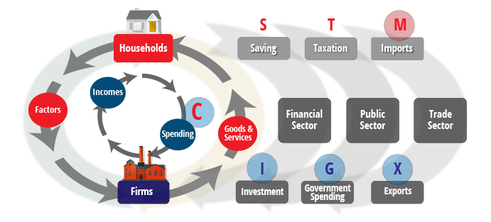

Slide 26
Aggregate Demand
Private Spending
Goods and Services consumed by individuals,
Businesses for investment
Net exports (exports minus imports
Public Spending
Revenues from taxes and other sources
These taxes are spent on health care, education, pensions, social assistance and defence

Slide 27
Tax
Aggregate Demand
Gov. Spending
Aggregate Demand
Tax
Aggregate Demand
So, if private spending falls, governments may increase expenditures or reduce taxes

Slide 28
The Objective of Fiscal Policy
“The objective is to keep a growing labour force and the country's stock of industrial plants and machinery employed at relatively high levels, but without generating inflation or having to rely on excessive foreign borrowing [debt to other countries] to pay for imported goods.”

Slide 29
Stop to read, think and share with a partner. Then draw an image, flow chart, etc. to illustrate the concept.
All other things being equal, if government revenues (taxes) increase more than expenditures (government spending), the resulting improvement in the budget balance (increase in the surplus or decrease in the deficit) tends to reduce aggregate demand, putting downward pressure on output, incomes, employment, and eventually prices. On the other hand, if government spending increases more than revenues, the resulting deterioration in the budget balance (increase in the deficit or decrease in the surplus) raises aggregate demand, bolstering output, incomes, employment, and consequently prices. (Canadian Encyclopedia)

Slide 30
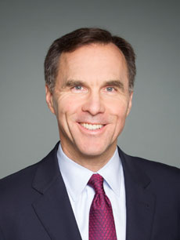
Who’s in charge of fiscal policy?
Federal Government
The federal minister of finance presents the annual federal budget which includes:
Planned expenses
Anticipated revenues from taxes
Whether or not a deficit is expected
Provinces play a smaller role
The Honourable Bill Morneau

Slide 31
Surplus and Deficits over the years
https://tradingeconomics.com/canada/government-budget

Slide 32
Reading – The Evolution of Fiscal Policy in Canada - 6 Sections
How would you like to share the information?

